Slide 1


Design Optimization of CPU Heatsinks for Enhanced Thermal Management
Team name

Slide 2
Team
Present your teammates (Names, age, where are you from, which university, which faculty and course,
what role did you have)

Slide 3
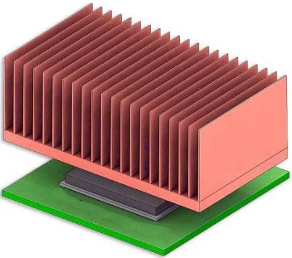
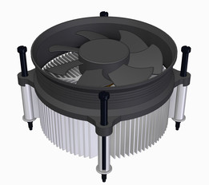
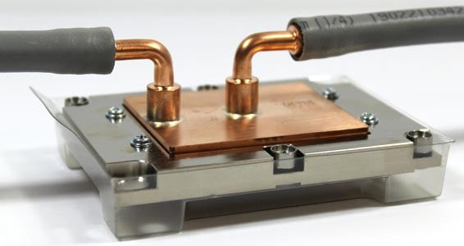
Problem statement
Design Optimization of CPU Heatsink/Cold Plate
We should design, analyse, and optimise a CPU heat sink and cold plate to minimize the maximum temperature of the base (where it contacts the CPU) by optimizing the heatsink/cold plate geometry for uniform heat source
Natural convection without the need for forced air
Forced convection with the assistance of a fan
Liquid cooling with the assistance of a cold plate

Slide 4
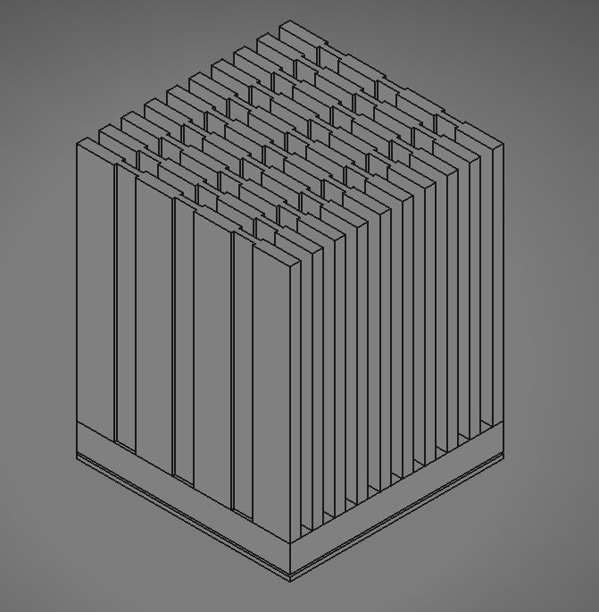
Task 1 - CPU Heatsink for Natural Convection
CPU TDP: 15 W
Max Operating Temp: 85°C
Ambient Temp: 25°C
Heatsink Dimensions: Compact size with an 80 mm x 80 mm footprint, max height of 100 mm.
Fin spacing (1.5 mm minimum) and variable thickness (1-3 mm) to enhance natural airflow.
Design Objective: Maximize heat dissipation through optimized fin geometry to support natural convection. The aim is to ensure sufficient cooling without forced airflow, suitable for low-power CPUs.

Slide 5
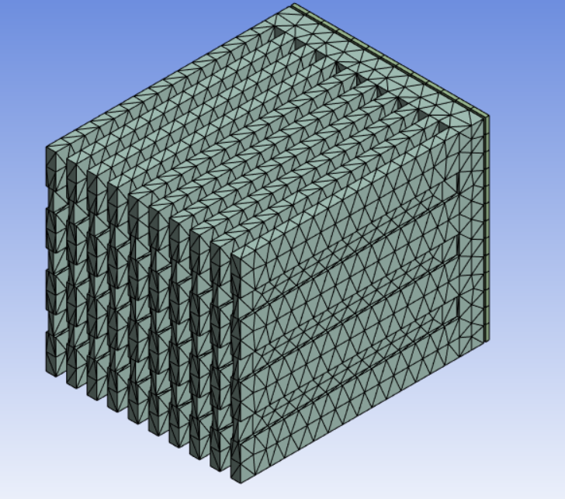
Meshing and Modeling Setup
Body Sizing: Applied to both Solid (CPU Heatsink) and Fluid (air) regions, with element sizes of 6.e-003 m and 2.1979e-002 m, respectively.
MultiZone Method: Used Hexa/Prism mesh for efficient thermal simulation with higher accuracy in solid areas.
Importance of Mesh Quality: A finer mesh improves result accuracy but increases computational load. The mesh was refined in areas close to the CPU-heatsink interface to capture detailed temperature and flow gradients.

Slide 6
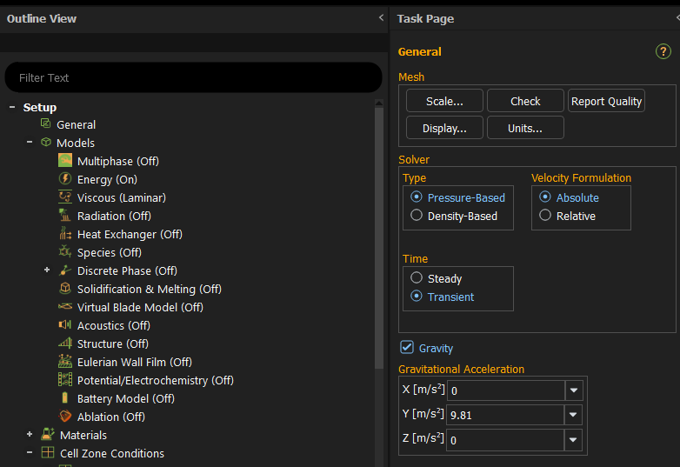
Simulation Settings and Convection Modeling
Material Creation in ANSYS Fluent:
For accurate simulation results, we specified distinct materials for each part of the model:
CPU: Modeled with “Silicon Pure” to reflect the thermal properties of silicon, which directly influences heat generation and flow.
Heatsink: Created with “Aluminum Alloy 3105-O” for high thermal conductivity, facilitating effective heat transfer from the CPU.
PCB: Defined as “Laminate Composite Epoxy-Material CEM-3,” which has moderate thermal conductivity suited for printed circuit boards.
Thermal Interface Material (TIM): Represented with "Copper Alloy C96200" for enhanced heat flow between the CPU and heatsink.
Energy Module: Enables heat transfer calculations.
Laminar Flow: Ideal for low Reynolds number, suitable for natural convection without turbulence.
Gravity and Variable Density: Gravity was set along the Y-axis to simulate buoyancy effects, causing warm air to rise and cool air to sink. This is essential for modeling natural convection around the heatsink.

Slide 7
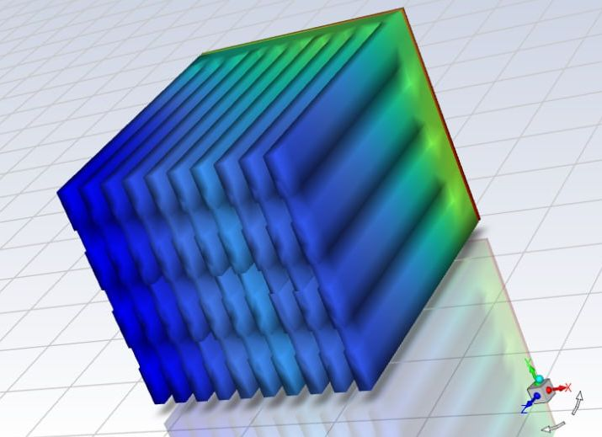
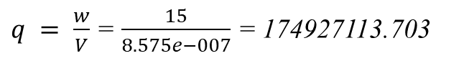
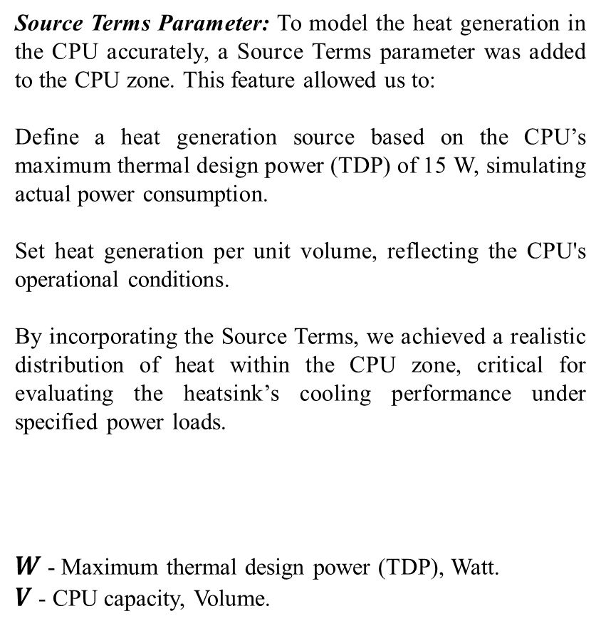
Task 1. Results
Source Terms Parameter: To model the heat generation in the CPU accurately, a Source Terms parameter was added to the CPU zone. This feature allowed us to:
Define a heat generation source based on the CPU’s maximum thermal design power (TDP) of 15 W, simulating actual power consumption.
Set heat generation per unit volume, reflecting the CPU's operational conditions.
By incorporating the Source Terms, we achieved a realistic distribution of heat within the CPU zone, critical for evaluating the heatsink’s cooling performance under specified power loads.
$W$ - Maximum thermal design power (TDP), Watt.
$V$- CPU capacity, Volume.
$q = \frac{w}{V}$ = $\frac{15}{8.575e−007}$ = 174927113.703
Temperature distribution in the body

Slide 8
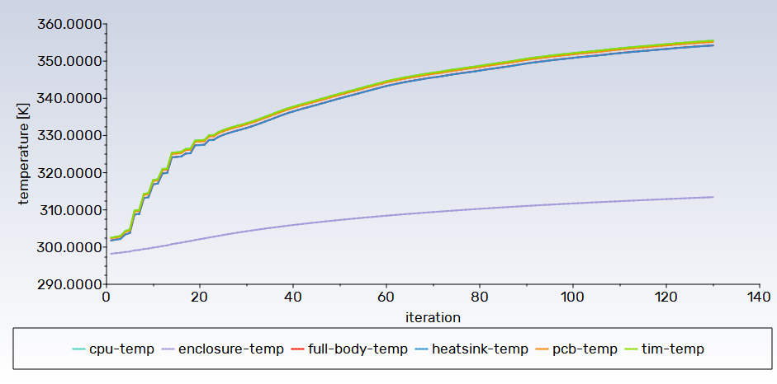
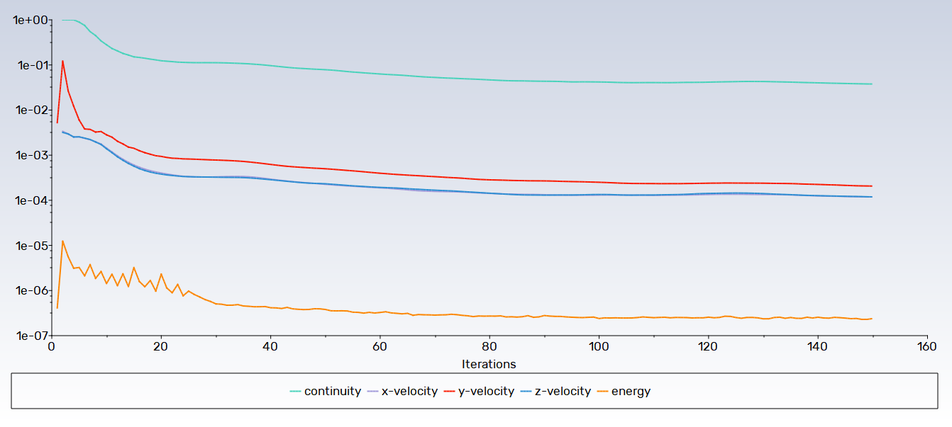
Task 1. Results
Temperature vs. Iterations: Graph shows temperature stabilization across the heatsink, indicating effective heat transfer.
Heat Flux Analysis: Reveals consistent heat dissipation across CPU surfaces, with no significant hotspots.
Conclusion:
The heatsink achieved stable cooling performance under natural convection, maintaining the CPU within safe temperature limits without forced airflow.
Temperature dependence on iterations
Dependence of System Energy on x-velocity, y-velocity, z-velocity and continuity on the number of iterations

Slide 9
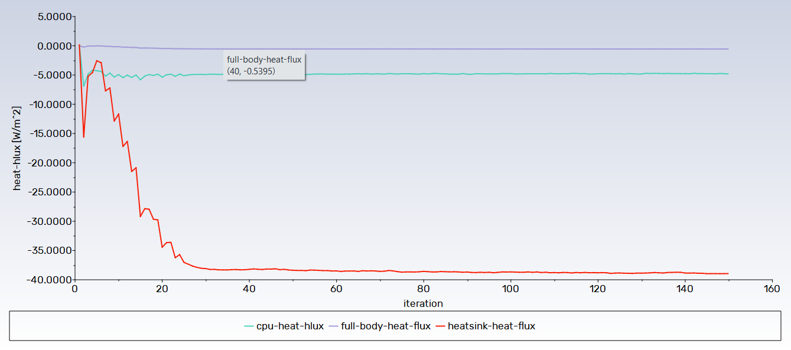
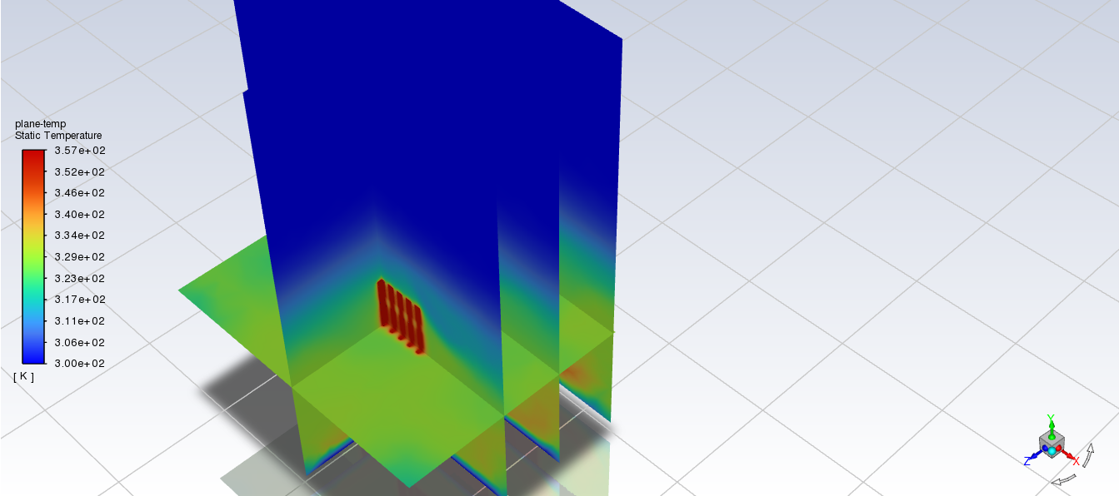
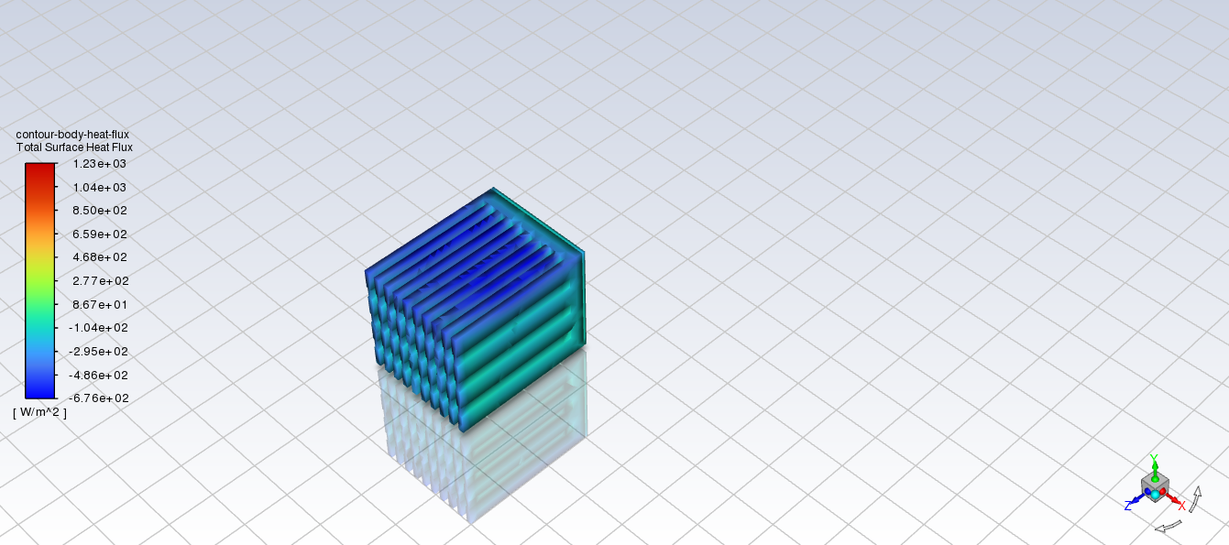
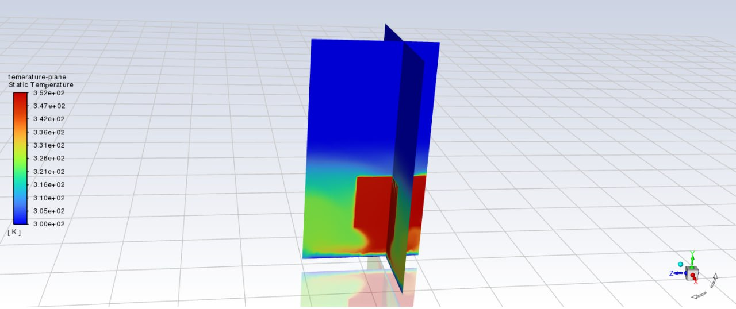
Heat Flux dependence of the system on the number of iterations
Static Temperature Plane

Slide 10
Task 2 - Enhanced Heatsink with Airflow
Objective: To adapt the original design for a higher CPU TDP (150 W) by incorporating forced airflow.
To calculate 19.613 Pa from a pressure of 2 mm water column, we use the following approach:
Water Column Pressure Value: One millimeter of water column contains approximately 9.80665 Pascals.
Calculation: To get the equivalent value in Pascals for 2mm of water column, we multiply 9.80665 Pa by 2.
2mmHg ×9.80665Pa/mmHg =19.6133Pa.
Answer: We round to two decimal places and get 19.61 Pa.
Airflow Speed: Set to 2 m/s at the inlet, 25°C ambient temperature.
Static Pressure: Applied at 19.613 Pa to simulate active cooling.

Slide 11
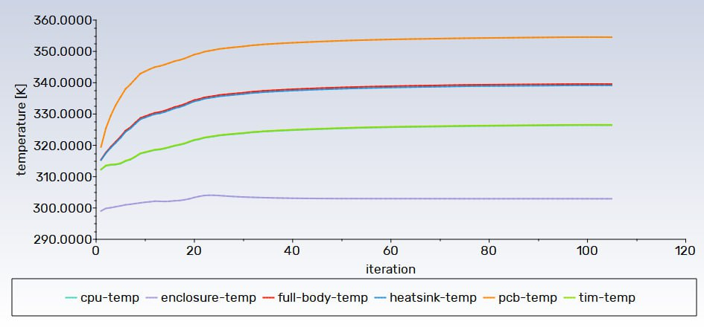
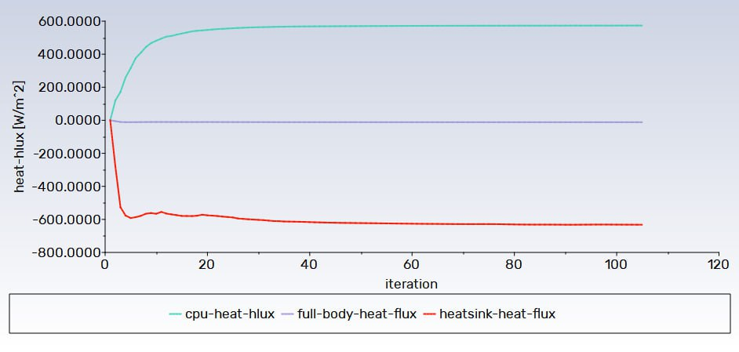
Task 2. Results
temperature dependence on iterations
Heat Flux dependence of the system on the number of iterations

Slide 12
Static Temperature Plane

Slide 13
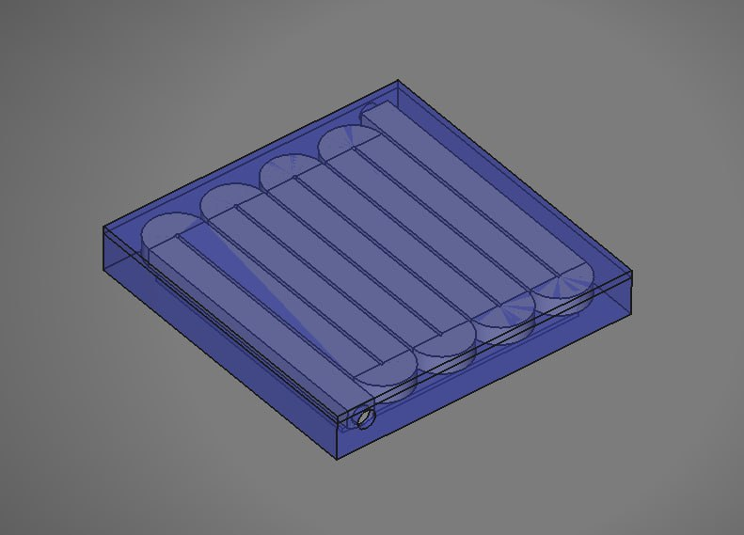
Task 1 - CPU Heatsink for Natural Convection
Objective: Design a cold plate with integrated channels for high TDP (250 W) CPUs.
Dimensions: 100 mm x 100 mm x 15 mm.
Channel Design: Widths of 0.5-3 mm and spacing of 1 mm to maximize heat transfer from CPU to liquid.
Thermal Interface Material (TIM): A 0.1 mm TIM layer ensures optimal contact between CPU and cold plate, minimizing thermal resistance.
Conclusion: The channel layout and cold plate structure enhance heat transfer efficiency, providing reliable cooling for high-performance CPUs.

Slide 14
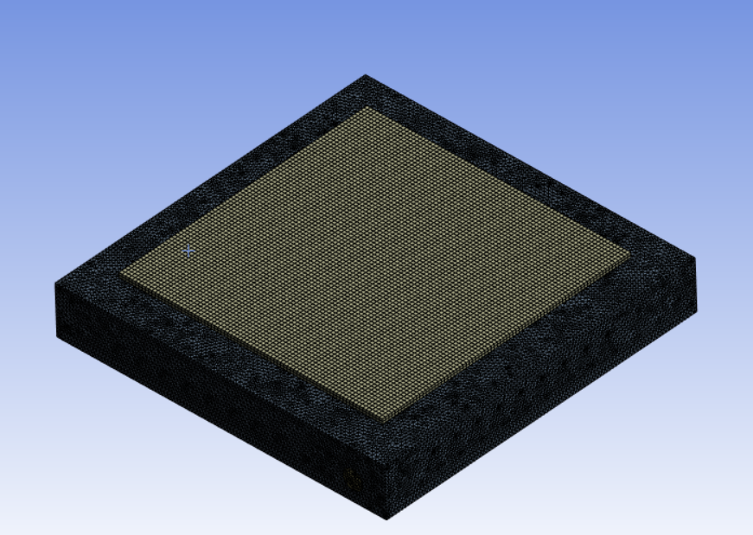
Cold Plate Mash
To simulate the cold plate accurately in ANSYS Fluent, we developed a detailed mesh that accommodates the unique geometry of the liquid cooling channels while maintaining computational efficiency. The mesh setup was crucial for achieving accurate results in modeling heat transfer between the CPU and the cooling fluid.
Overall Element Size: We set an element size of 1.e-003 m to balance accuracy and computation time. This scale was chosen to capture detailed thermal gradients within the cold plate and fluid regions without excessive computational load.

Slide 15
Cold Plate Simulation Parameters
Inlet Flow Rate: 2 l/min, Inlet Temp 25°C.
Pressure Drop: 0.5 bar, adjusted for flow dynamics.
Results:
Temperature and Heat Flux vs. Iterations: Graph shows a stable temperature and efficient heat dissipation with high heat flux.
Conclusion: Liquid cooling maintains CPU temperature well within safe limits, even under high loads, proving effective for high TDP applications.
Water-liguid was taken as fluid parameter, the following parameters were taken as solid objects:
1.Cold plane as aluminium alloy wrought 3015 o
2.CPU as silicon pure
3.PCB as pcb laminate
4.TIM as cooper alloy c96200

Slide 16
Cold Plate Simulation Parameters
Velocity Inlet: The inlet boundary condition was defined as a Velocity Inlet based on a specified volumetric flow rate of 2 l/min. Given the pipe diameter of 6 mm, the equivalent inlet velocity was calculated as approximately 1.18 m/s.
Pressure Outlet: The outlet boundary was set as a Pressure Outlet with a maximum allowable pressure drop of 0.5 bar, converted to 50,000 Pa.
This setup ensures that the model accurately reflects the specified fluid dynamics and thermal conditions within the cold plate system.
All other steps of model creation are done in the same way as in the previous tasks.

Slide 17
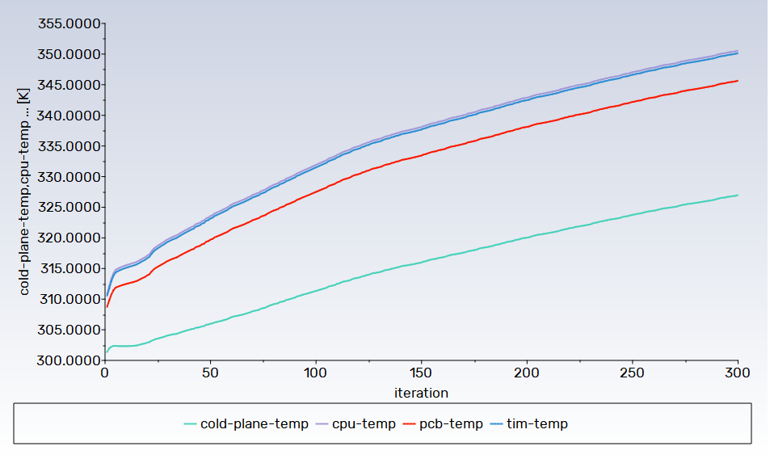
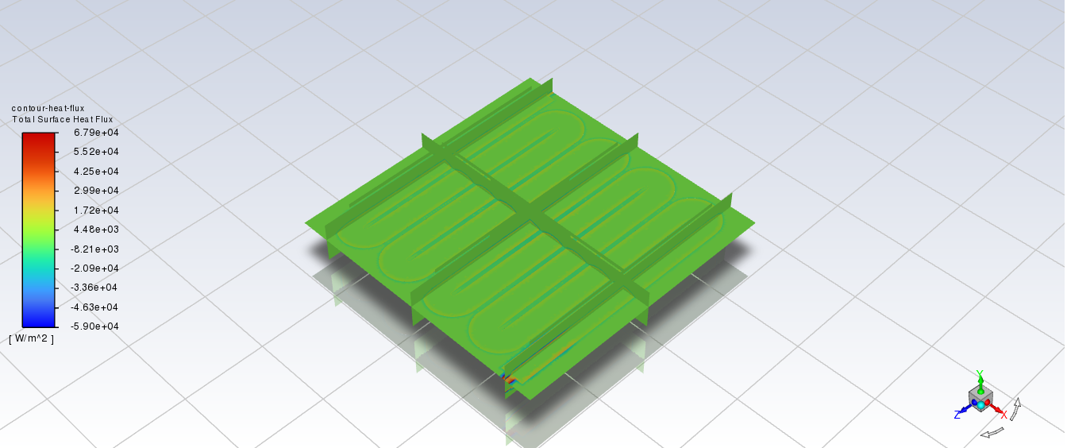
Cold Plate Simulation and Results
temperature dependence on iterations
heat flux plane

Slide 18
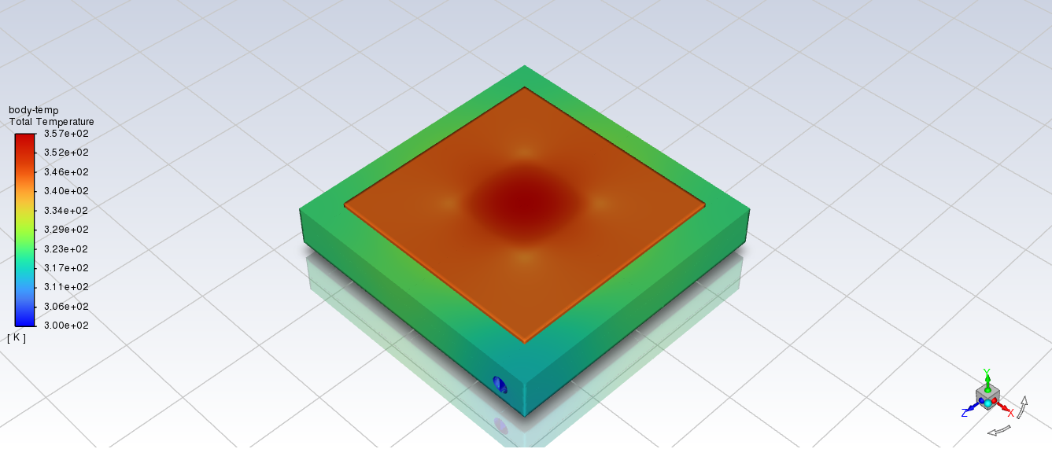
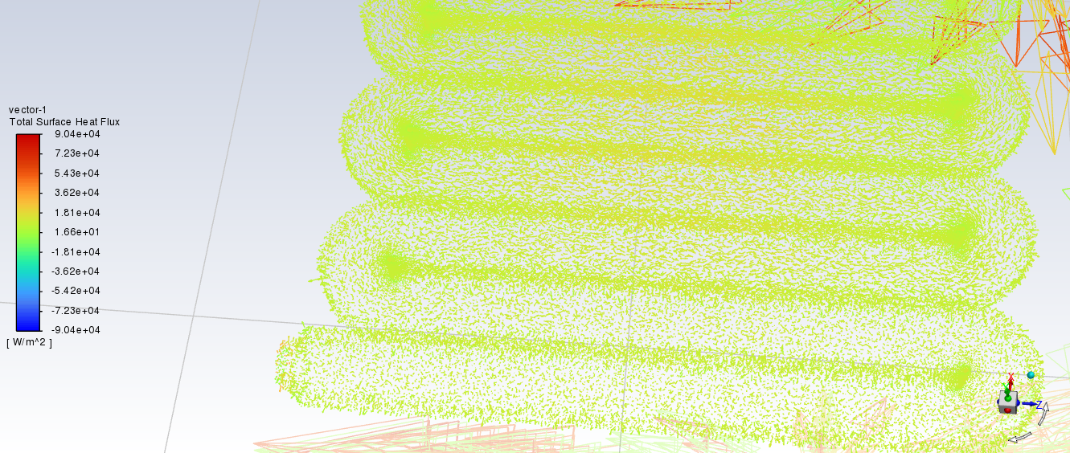
Cold Plate Simulation and Results
temperature body
heat flux vectors

Slide 19
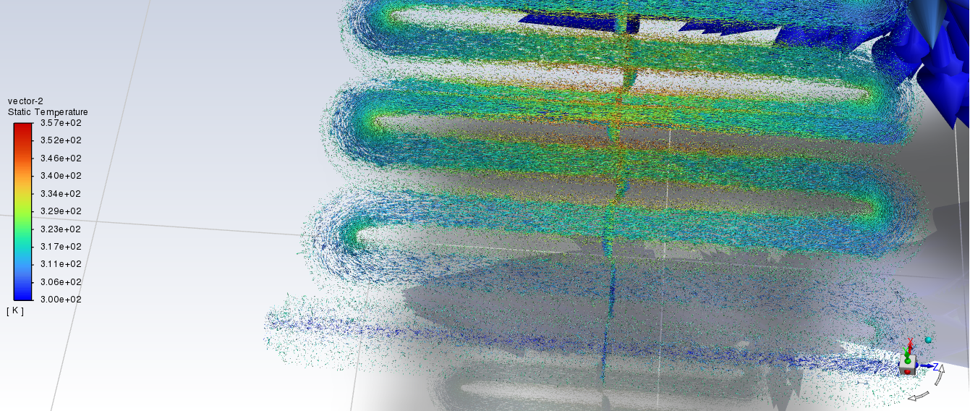
Cold Plate Simulation and Results
temperature vectors

Slide 20
Cold Plate Summary and Key Takeawaysand Results
Natural Convection Heatsink: Suitable for low-power CPUs, efficient passive cooling with optimized fin geometry.
Enhanced Convection Heatsink: Adapted for forced airflow, suitable for moderate thermal loads.
Cold Plate Liquid Cooling: Ideal for high-power CPUs, achieves efficient cooling through liquid-cooled channels.
Explore alternative materials for improved conductivity and advanced geometries for multi-layer cooling solutions, further enhancing thermal efficiency and scalability.
In the same way, another needle and radiator model can be developed and modeled

Slide 21
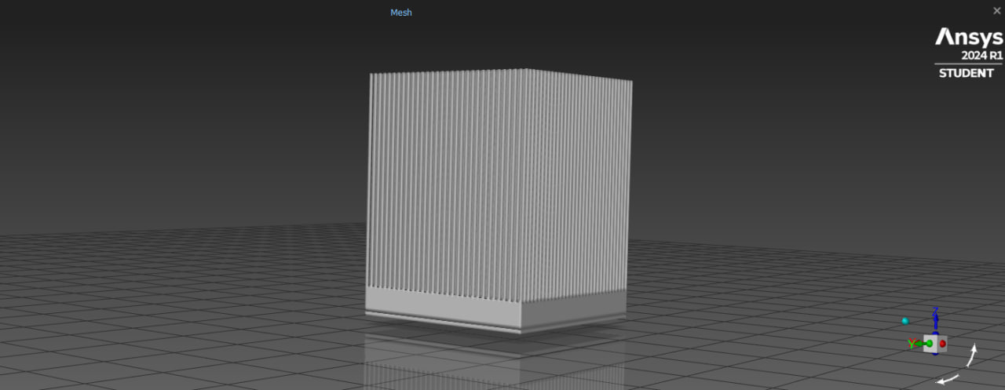
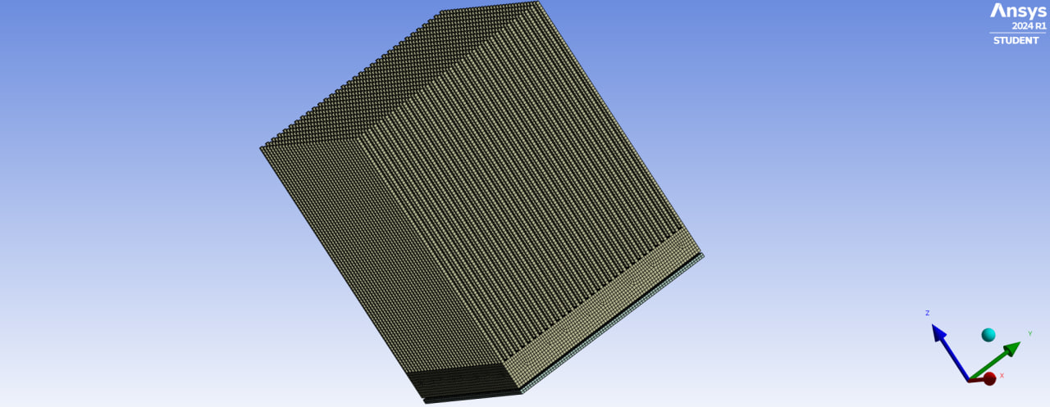
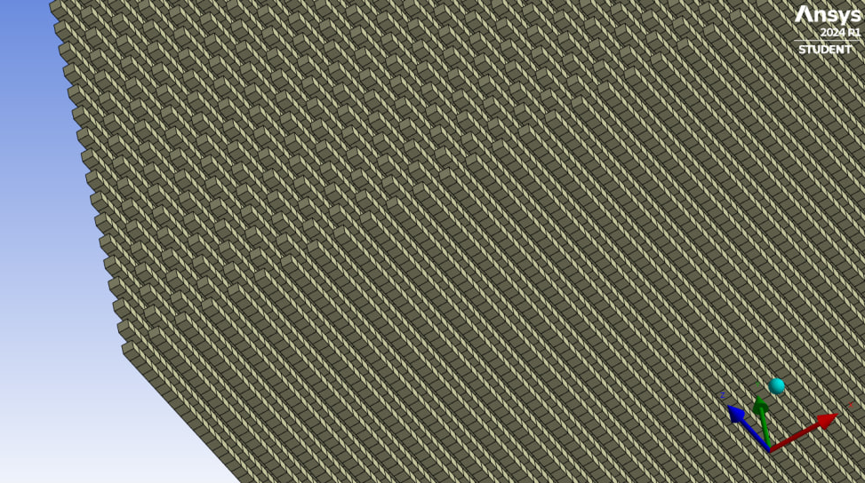
Competitors. Needle radiator model

